Slide 1



Making better conservation decisions
Jeffrey Hanson
jeffrey.hanson@uqconnect.edu.au
jeffrey-hanson.com

Slide 2






Acknowledgements
Adam Marques
Ana Veríssimo
Brandon Edwards
Caitlyn Proctor
Carlo Rondinini
Cynthia Riginos
Emma Hudgins
Francesco Ficetola
Graeme Buchanan
Guillermo Velo-Antón
Iadine Chadès
Íñigo Martínez-Solano
Hugh Possingham
Jenny McCune
Jonathan Rhodes
Joseph Bennett
Matthew Strimas-Mackey
Miguel Camacho-Sanchez
Nina Morell
Peter Arcese
Richard Fuller
Richard Schuster
Silvia Carvalho
Stuart Butchart

Slide 3
Now
Biodiversity
Status quo
2000
Future

Slide 4
Now
How do we
get here?
Biodiversity
Status quo
2000
Future

Slide 5
How can we get a better conservation decision?
(1) Better algorithms
(2) Better data
(3) Better surrogates

Slide 6



Ecological surveys
Distribution maps
Priority areas
Biodiversity
2000
Future
Data
Information
Plan
Outcome
Objectives
Constraints

Slide 7
Ecological surveys
Distribution maps
Priority areas
Biodiversity
2000
Future
Data
Information
Plan
Outcome
Better
algorithms
Better
outcome
Objectives
Constraints

Slide 8
Reserve selection
Features
Notes:
- not all remaining habitat can be preserved
- achieve conservation objectives for minimal cost
- modern systematic conservation planning primarily focusses on representing species
- however, this ignores intra-specific biodiversity
8

Slide 9
Reserve selection
Planning units

Slide 10
Reserve selection
?
?
?
?
?
?

Slide 11
Reserve selection

Slide 12





Heuristic
algorithm
Meta-heuristic
algorithms
Exact
algorithms
Estimate of best quality
Quality
Different
solutions
Different
solutions
Different
solutions

Slide 13




prioritizr R package
What you value
Input to solver
Data
Mathematical
optimization
problem
Biodiversity
Land use
Economic
Solve problem
What the solution
should (or not) do
Maps
Statistics
Hanson et al. 2023 CRAN

Slide 14
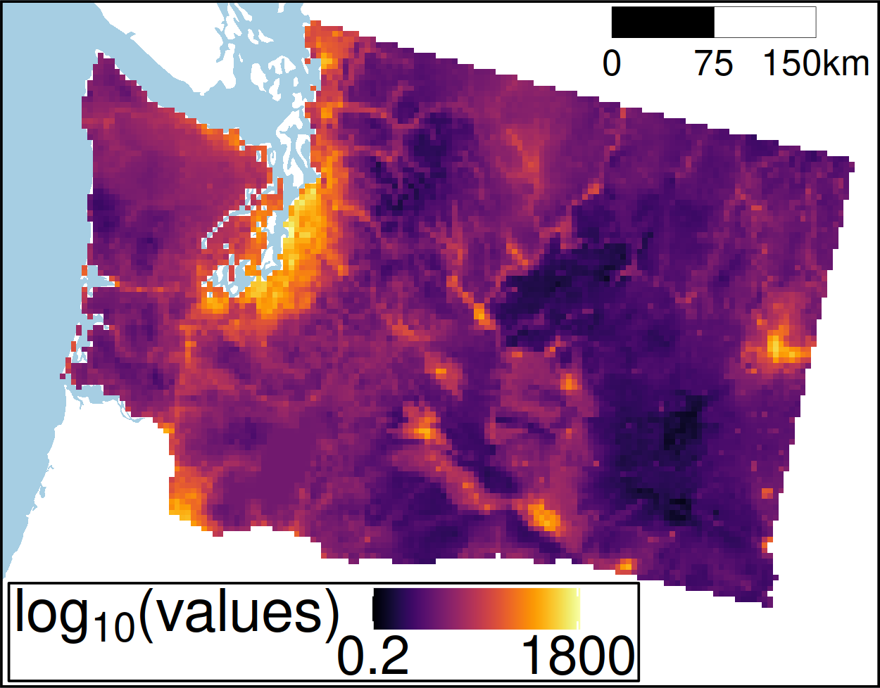
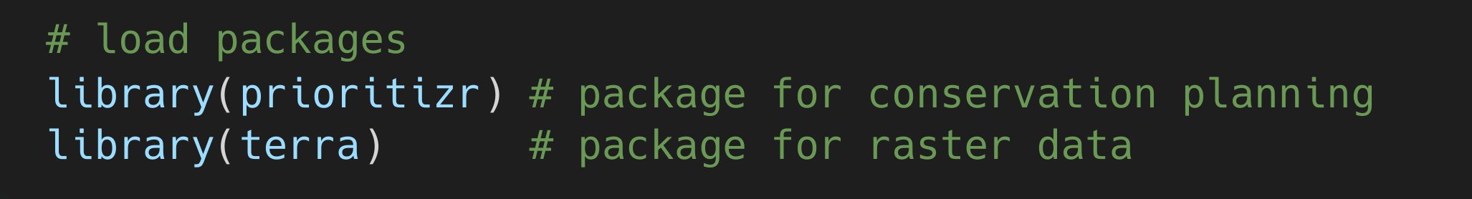
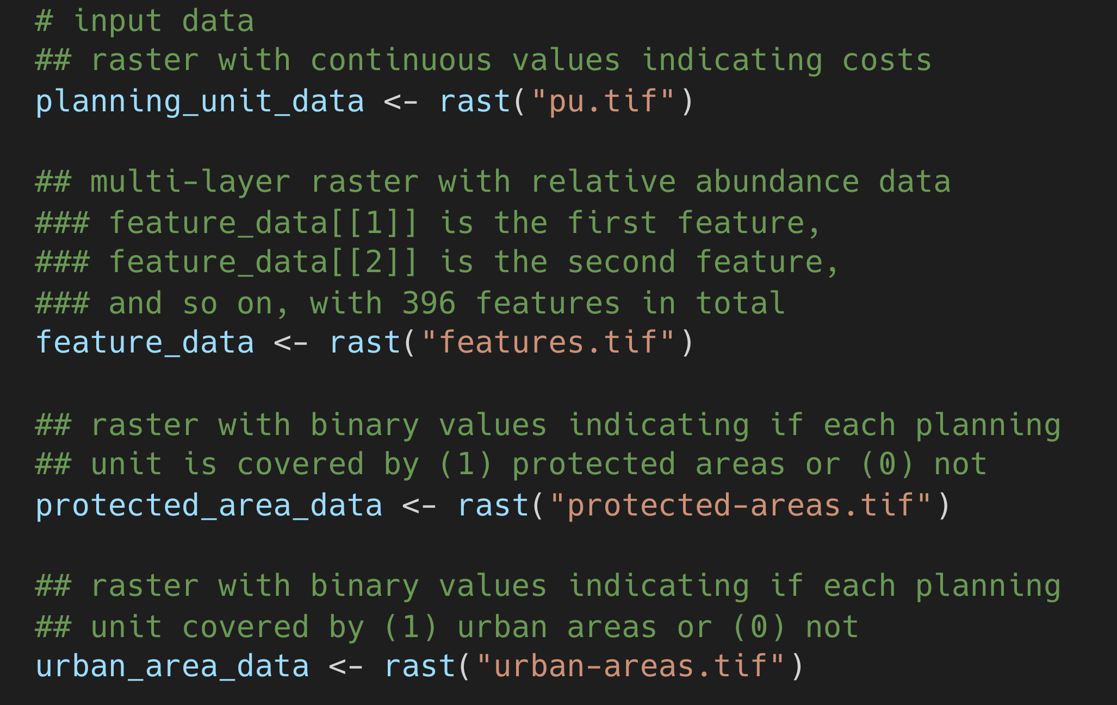
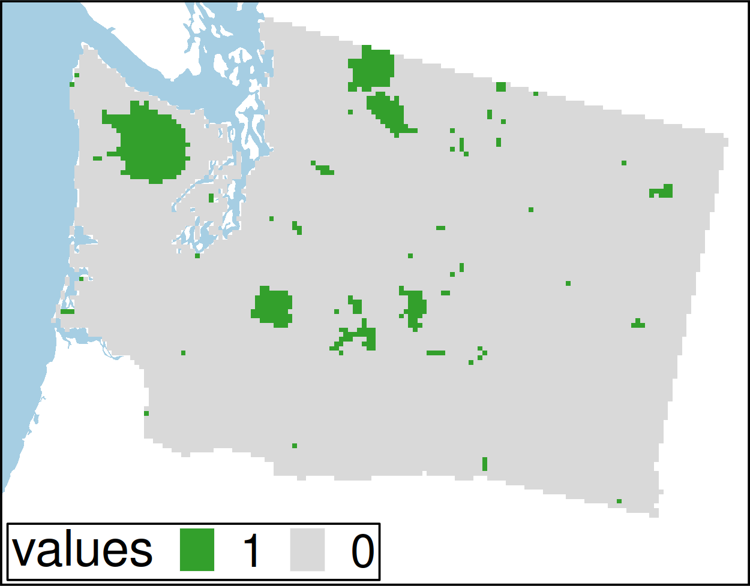
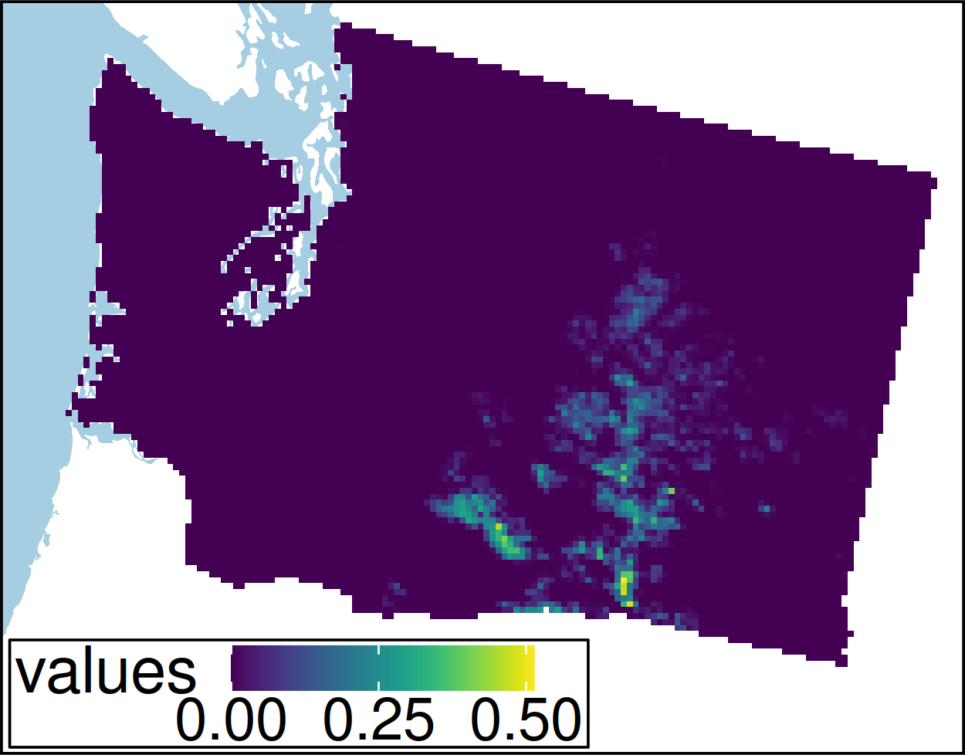
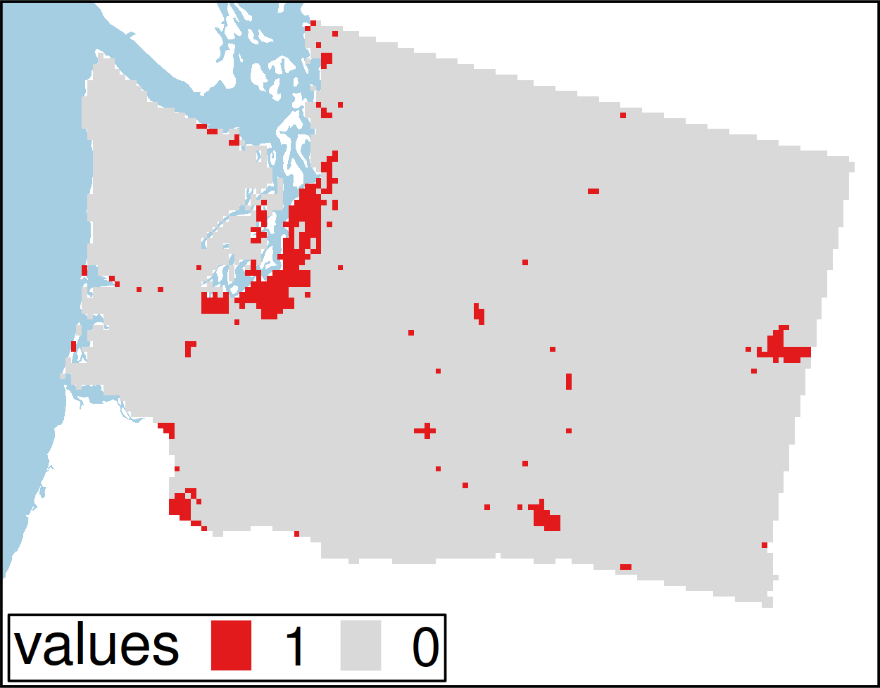
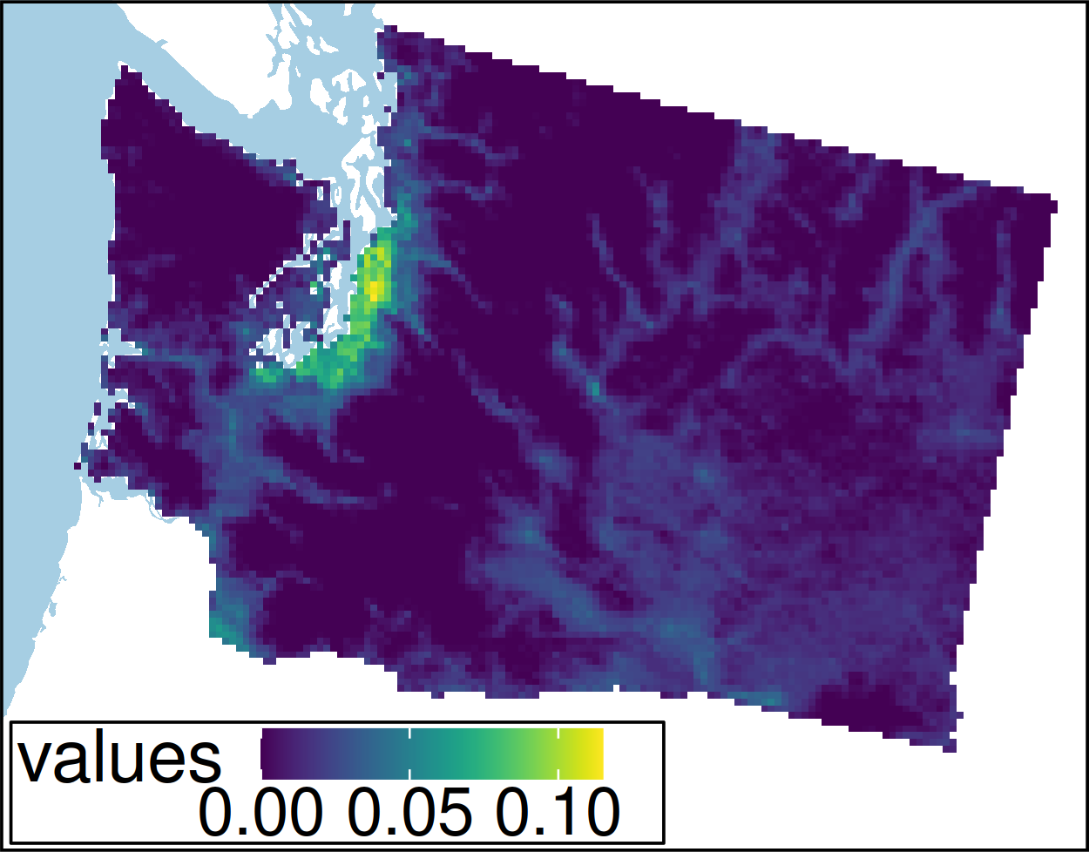
Worked example
Hanson et al. Under revisions

Slide 15
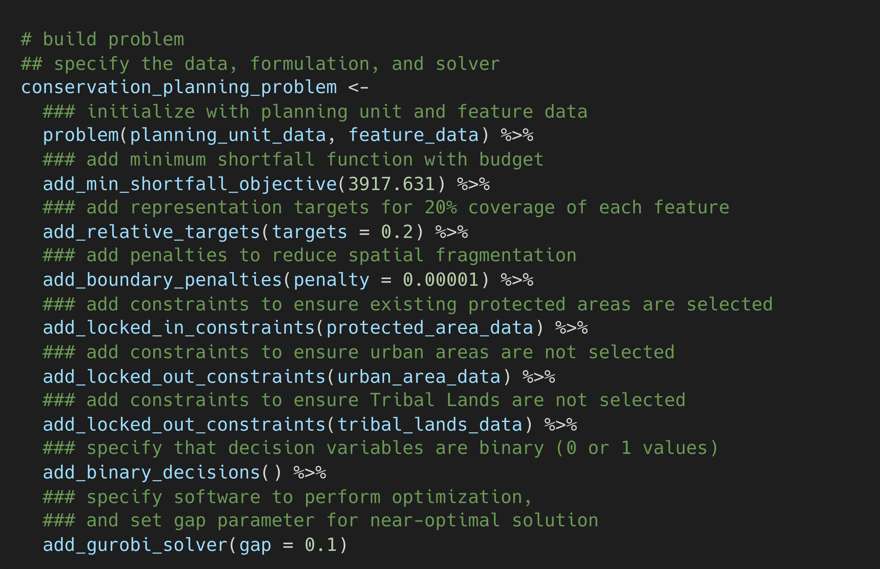
Hanson et al. Under revisions

Slide 16
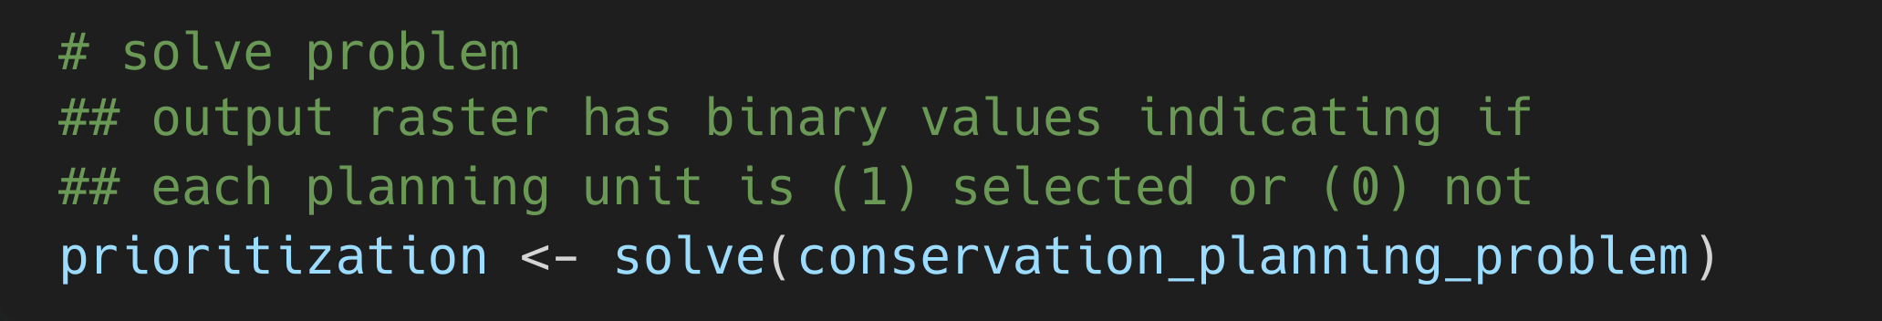
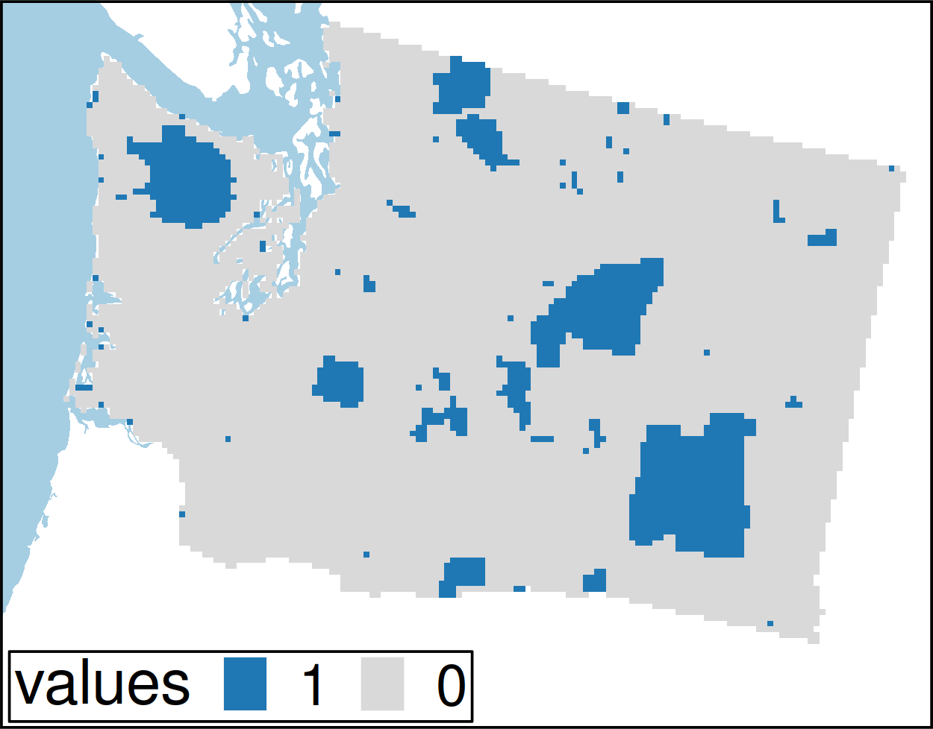
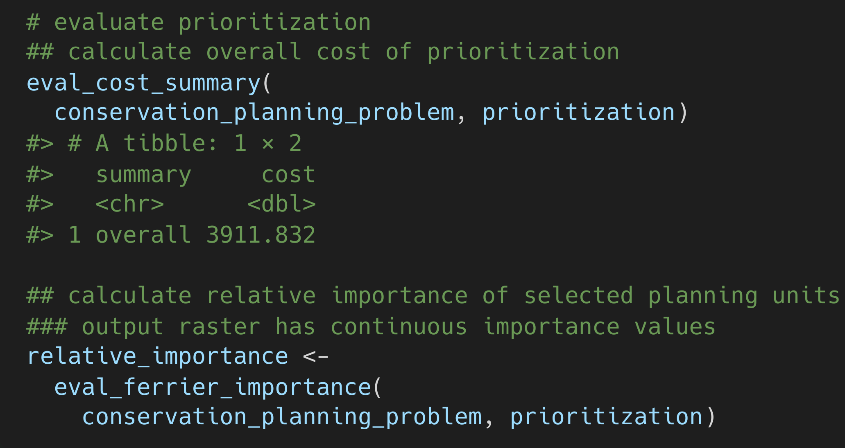
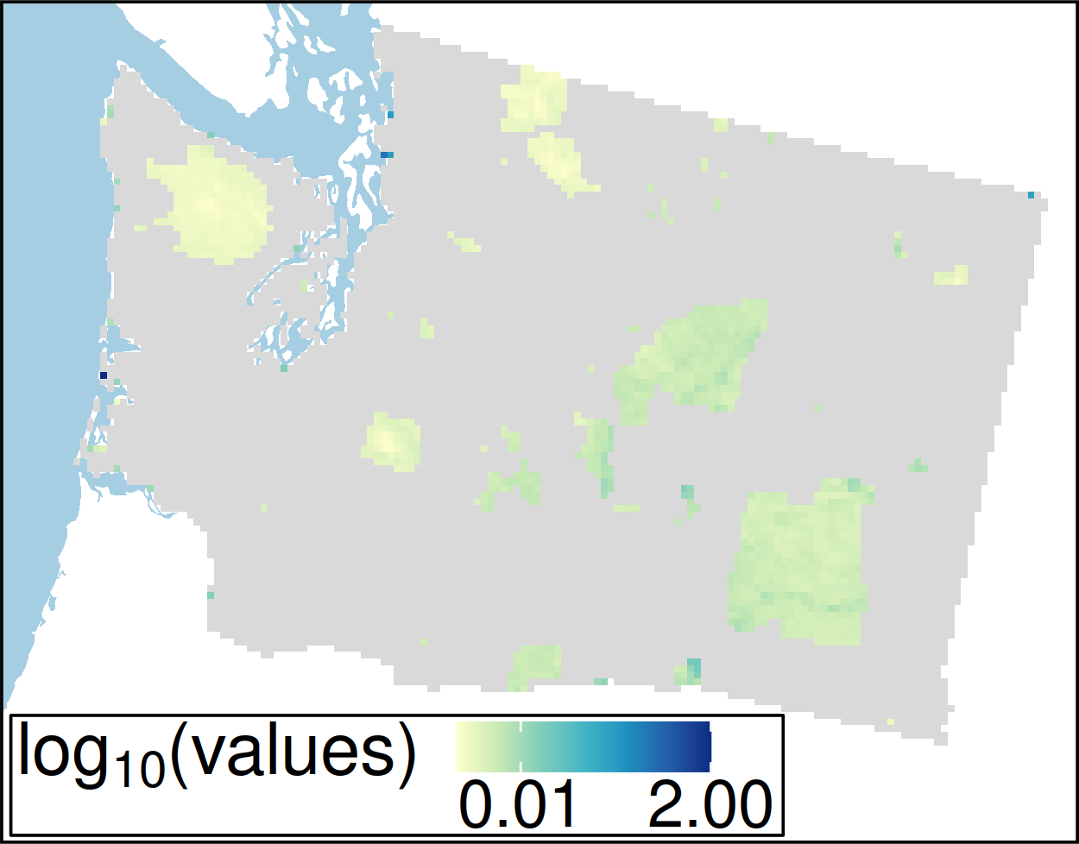
Hanson et al. Under revisions

Slide 17
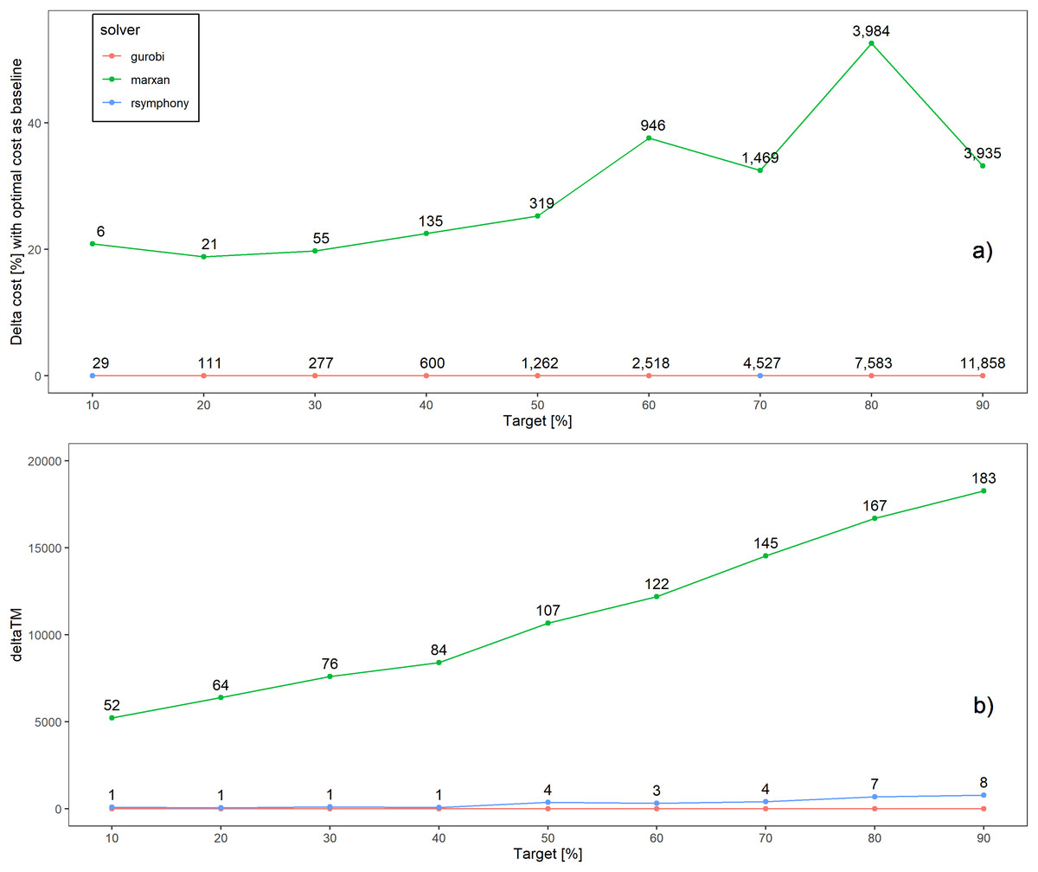
Better solutions
Schuster et al. 2020 PeerJ

Slide 18
…and faster too!
183x slower
52x slower
Time difference
Schuster et al. 2020 PeerJ

Slide 19
How can we get a better conservation decision?
(1) Better algorithms
(2) Better data
(3) Better surrogates

Slide 20
Ecological surveys
Distribution maps
Priority areas
Biodiversity
2000
Future
Data
Information
Plan
Outcome
Objectives
Constraints
Notes:
20

Slide 21

Ecological surveys
Distribution maps
Priority areas
Biodiversity
2000
Future
Data
Information
Plan
Outcome
Better
understanding
of biodiversity
Better
plan
Better
outcome
Genetic samples
Objectives
Constraints
Notes:
21

Slide 22
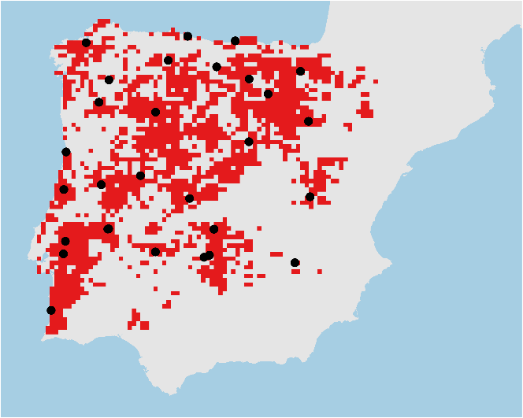
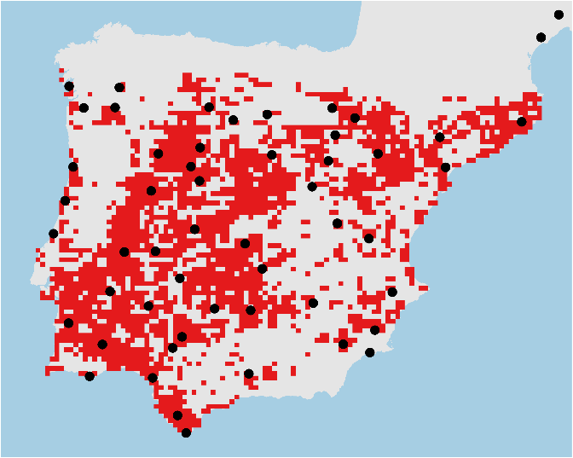
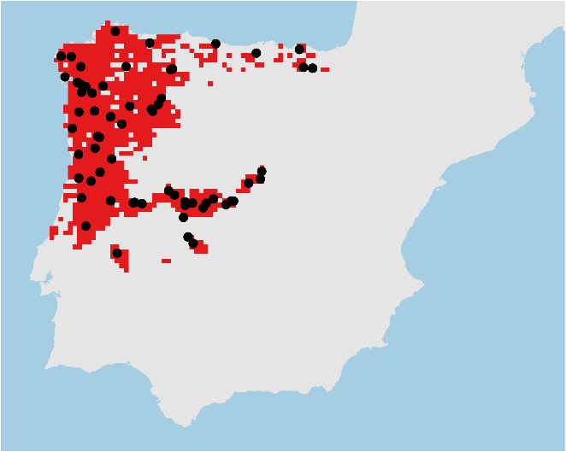

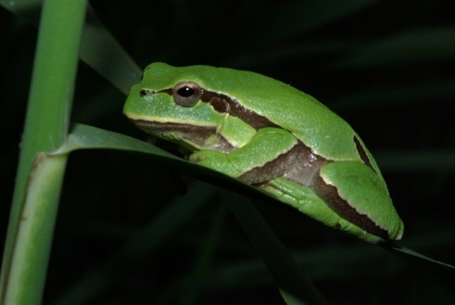
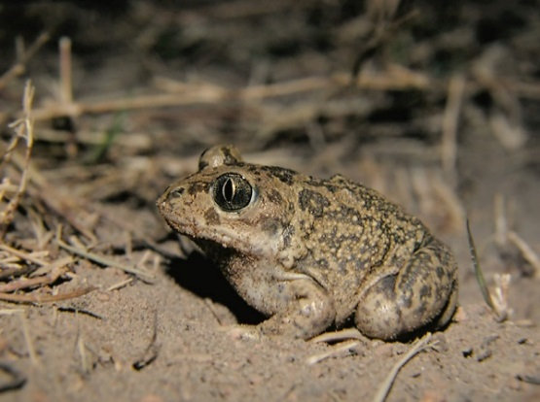
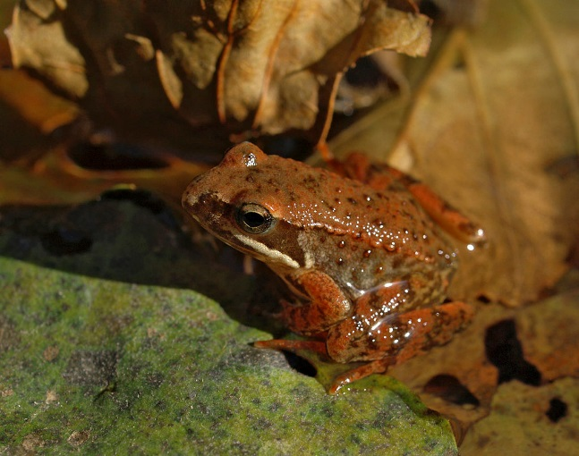
Conservation planning for adaptive and neutral evolutionary processes
Hyla molleri
Pelobates cultripes
Rana iberica

Slide 23
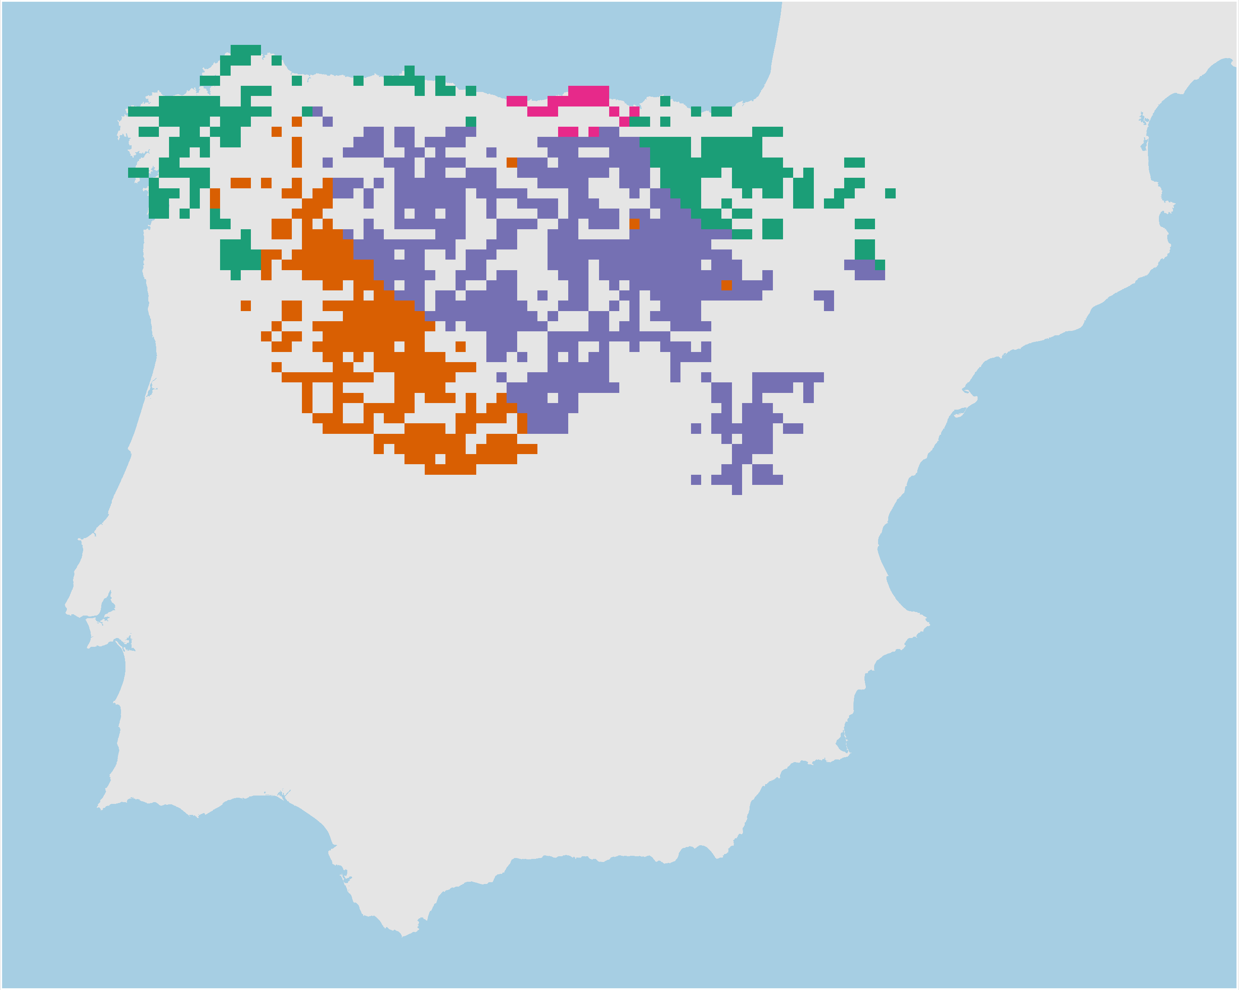
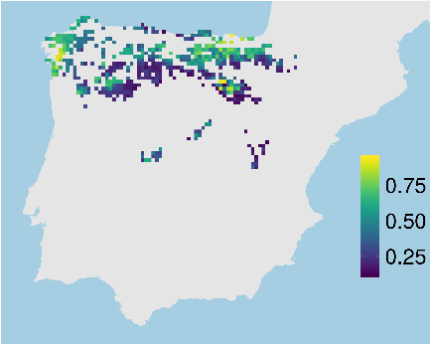
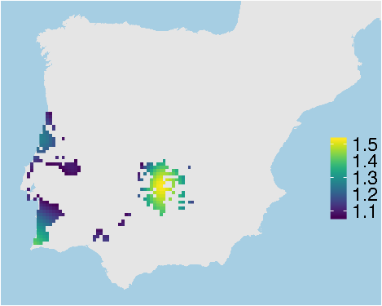
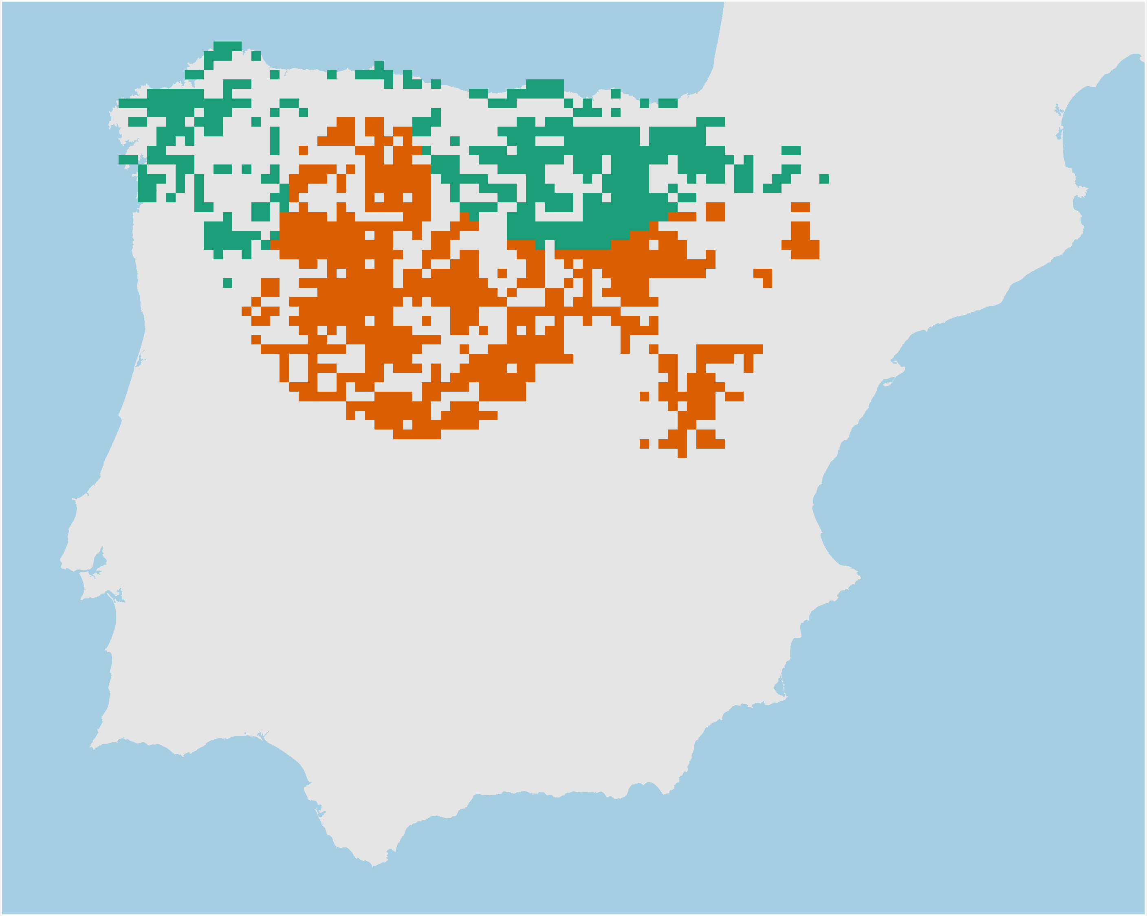
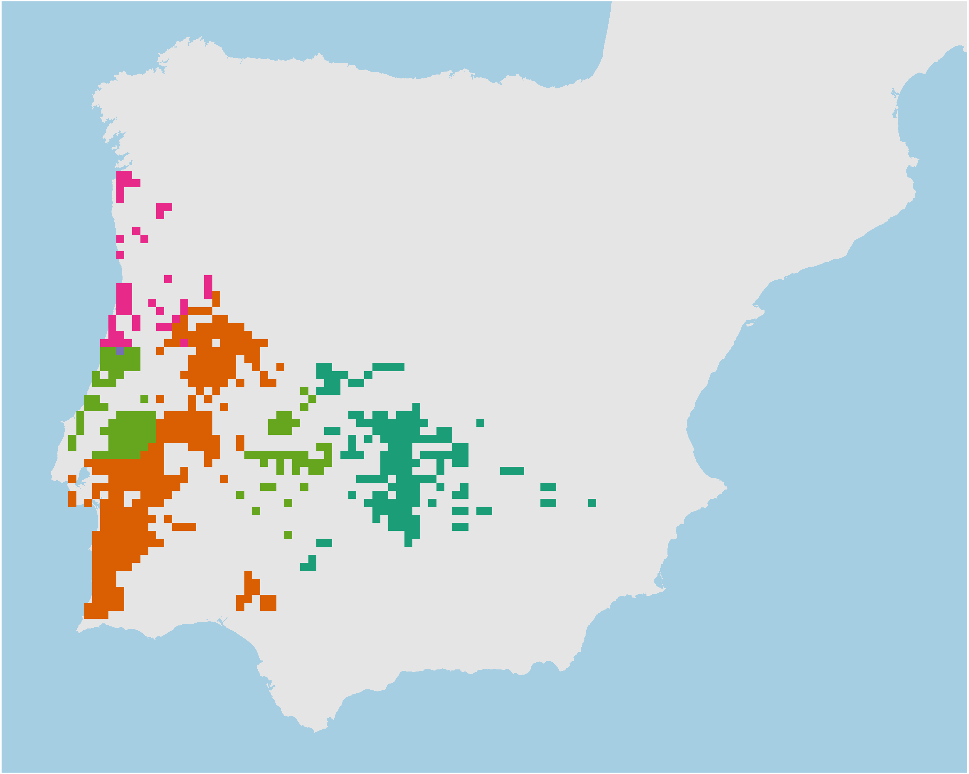
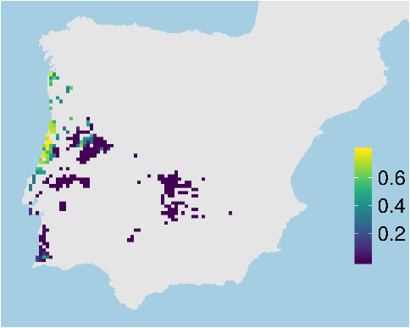
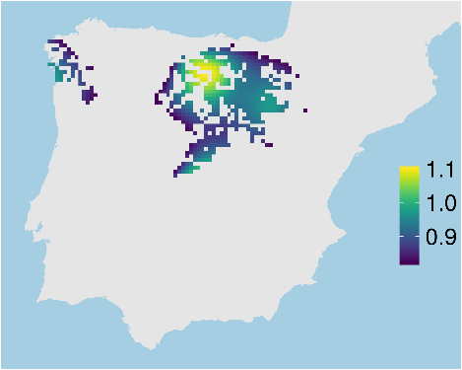
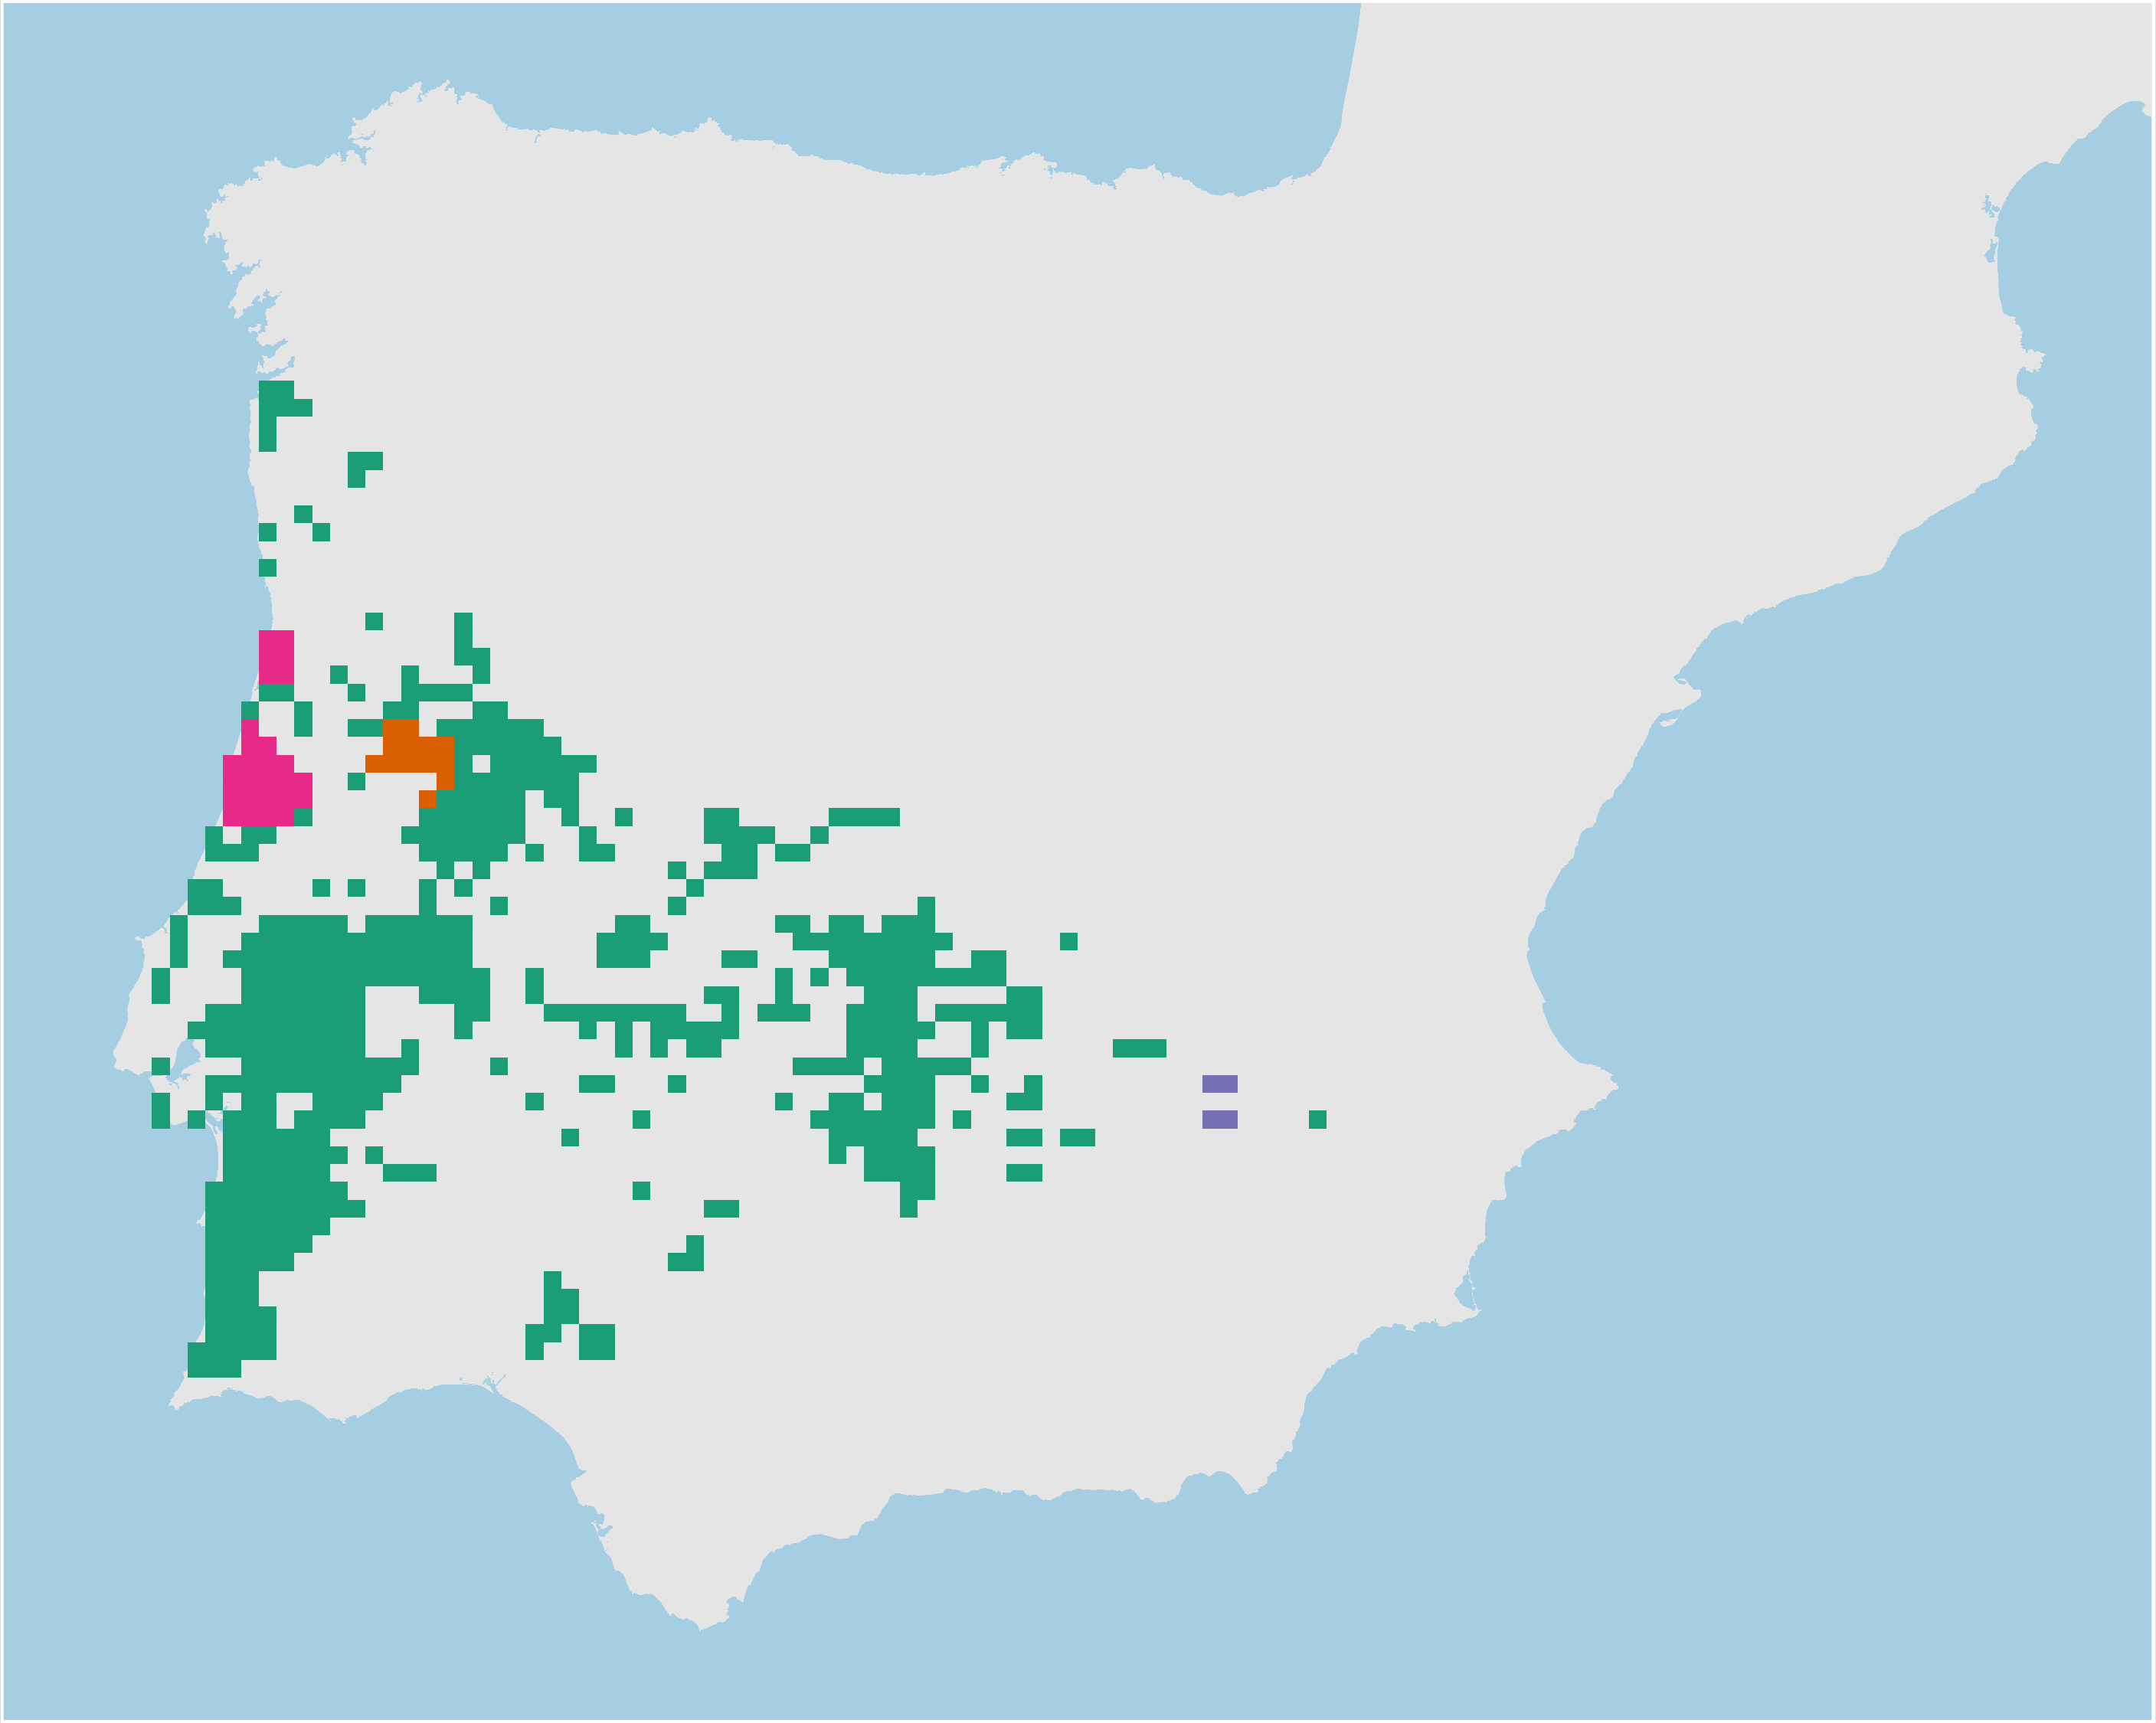
Adaptive processes
Neutral processes
Hyla molleri
Adaptive
clusters
Climate
refugia
Individual
heterozygosity
Neutral
clusters

Slide 24
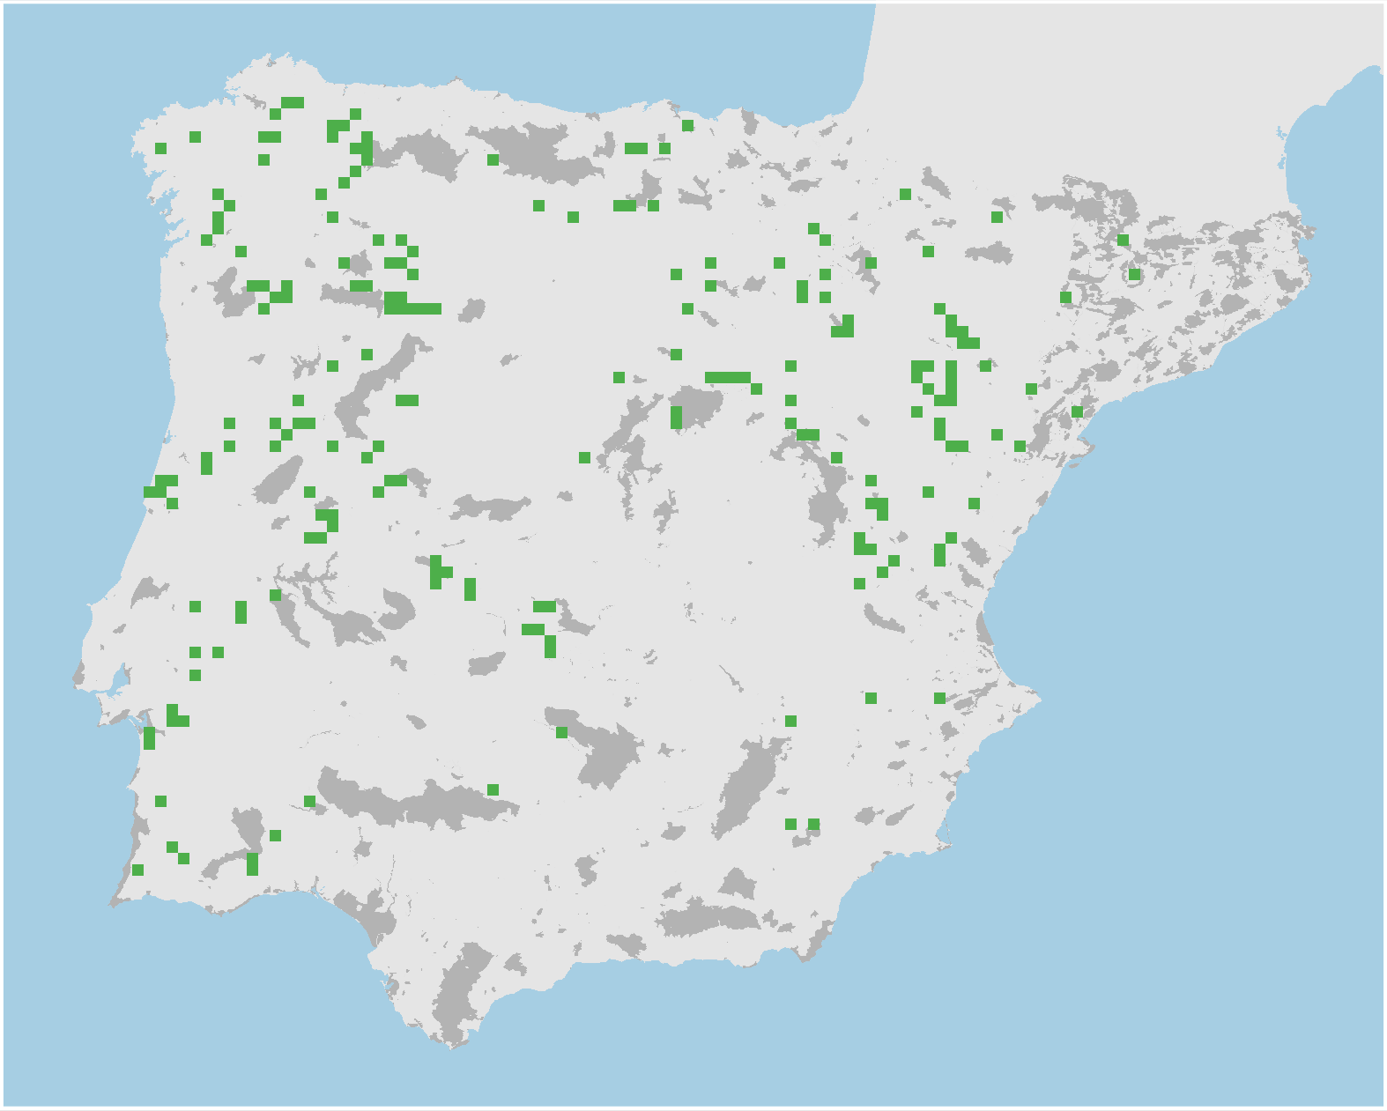
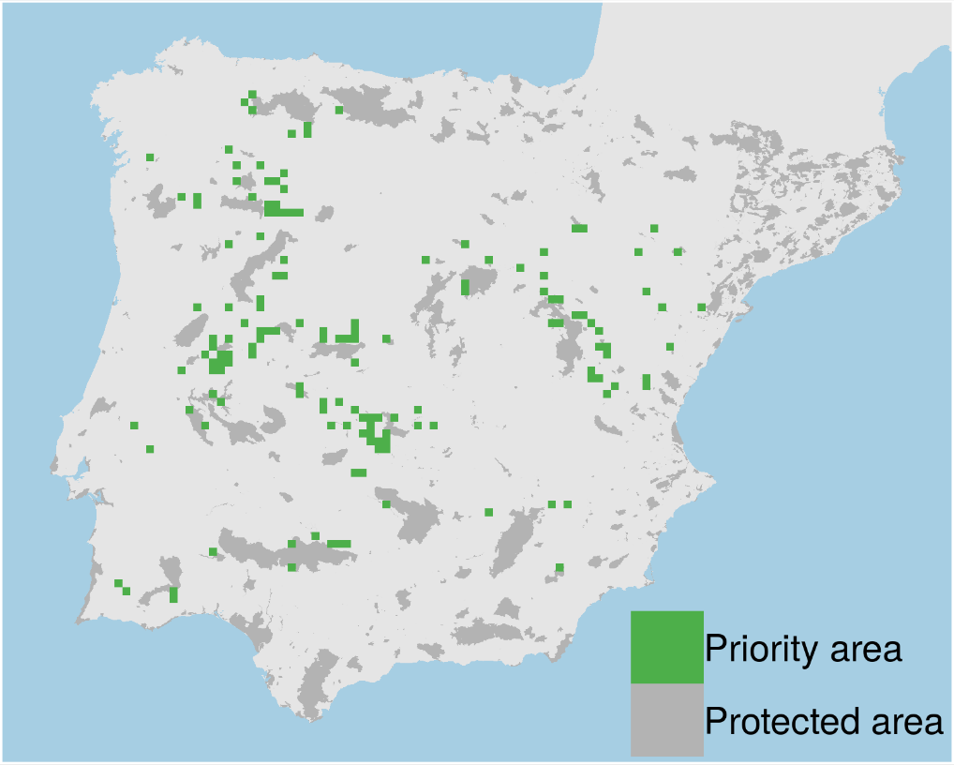
Prioritizations
Plan with evolutionary
attributes
Conventional plan
Only costs 9% less

Slide 25
However, more data isn’t always better…

Slide 26
Ecological surveys
Distribution maps
Priority areas
Biodiversity
?
?
?
?
?
?
2000
Future
Data
Information
Plan
Outcome
More
surveys
Better
models
Better
management
Better
outcome
Objectives
Constraints

Slide 27
Ecological surveys
Distribution maps
Priority areas
Biodiversity
?
?
?
?
?
?
?
?
?
?
?
?
2000
Future
Data
Information
Plan
Outcome
More
surveys
Better
models
Poorer
management
Worse
outcome
Objectives
Constraints
Less funding

Slide 28
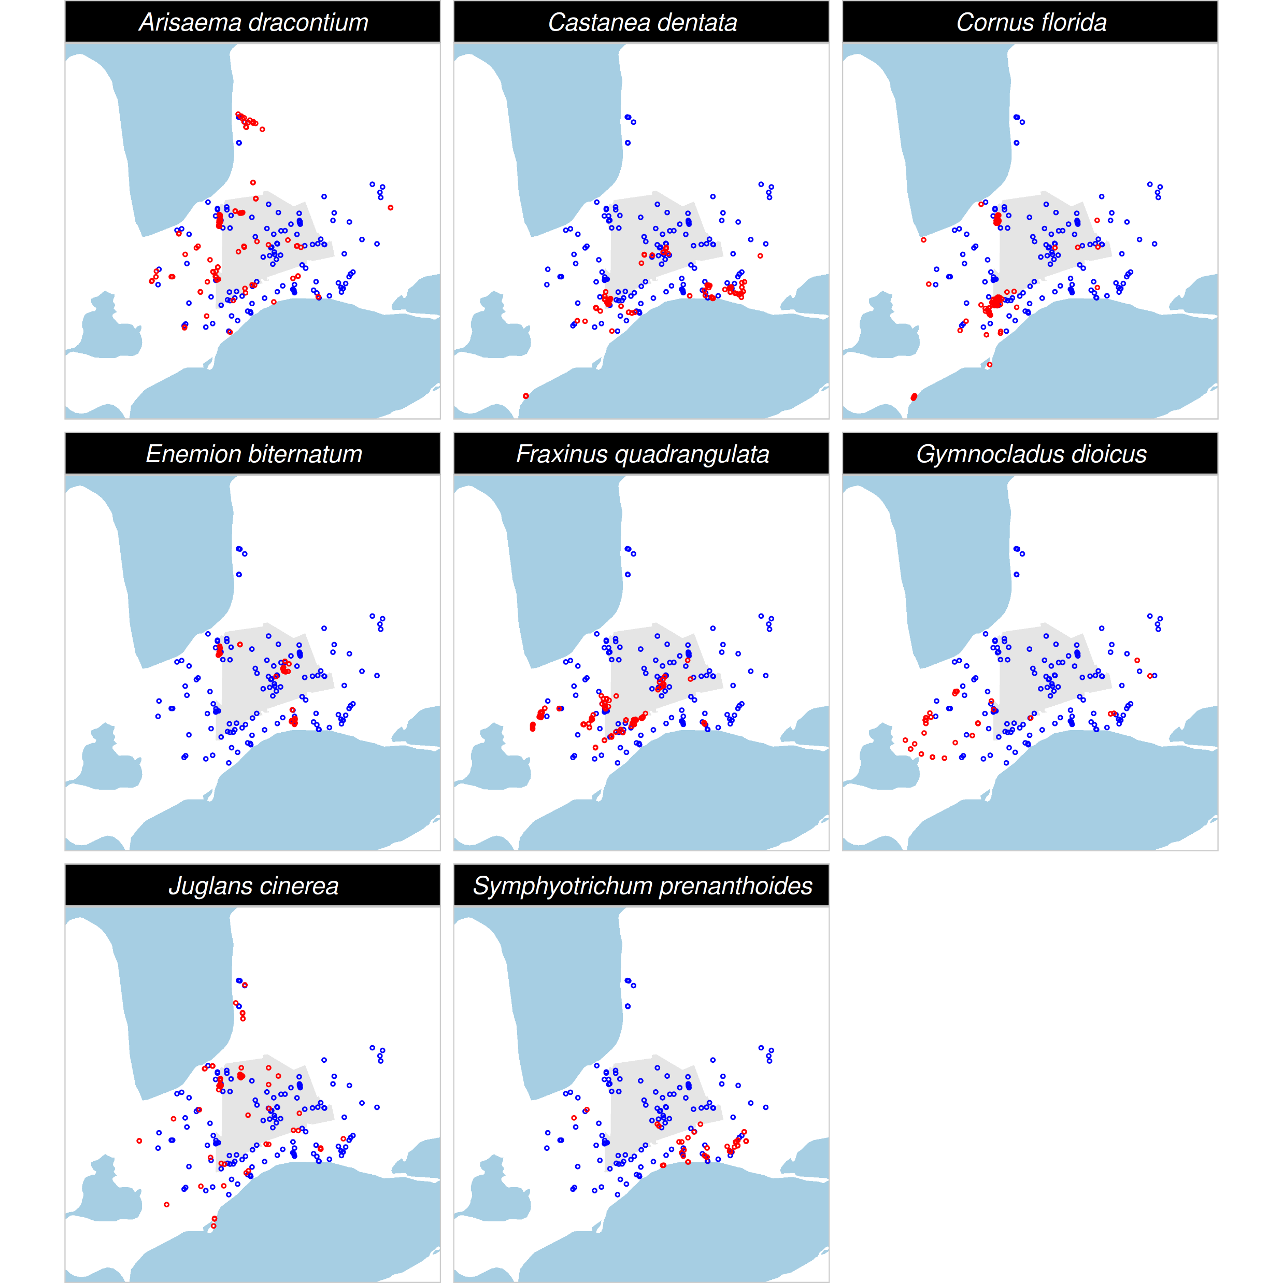
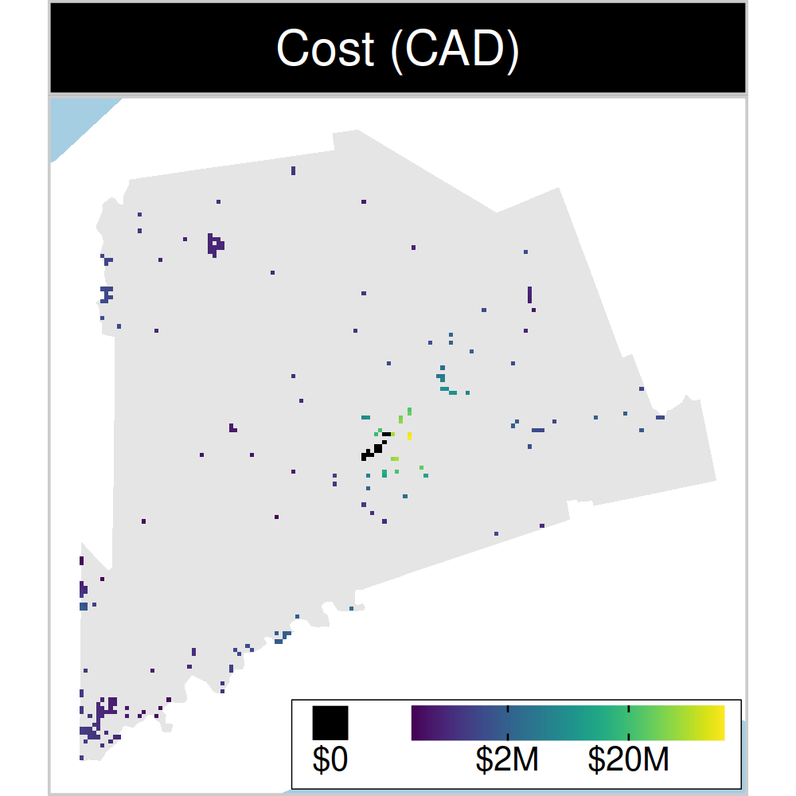
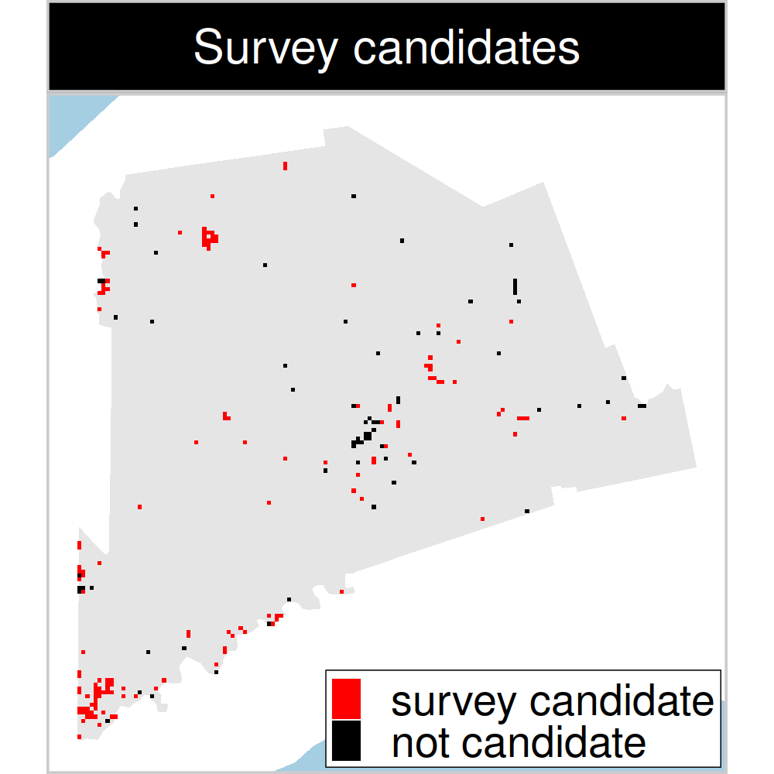
Study system: Middlesex county, Canada
199 places that could
potentially be acquired for
protected area establishment
143 places that could potentially be surveyed to
improve existing data
8 imperiled plant species
Notes:
28

Slide 29
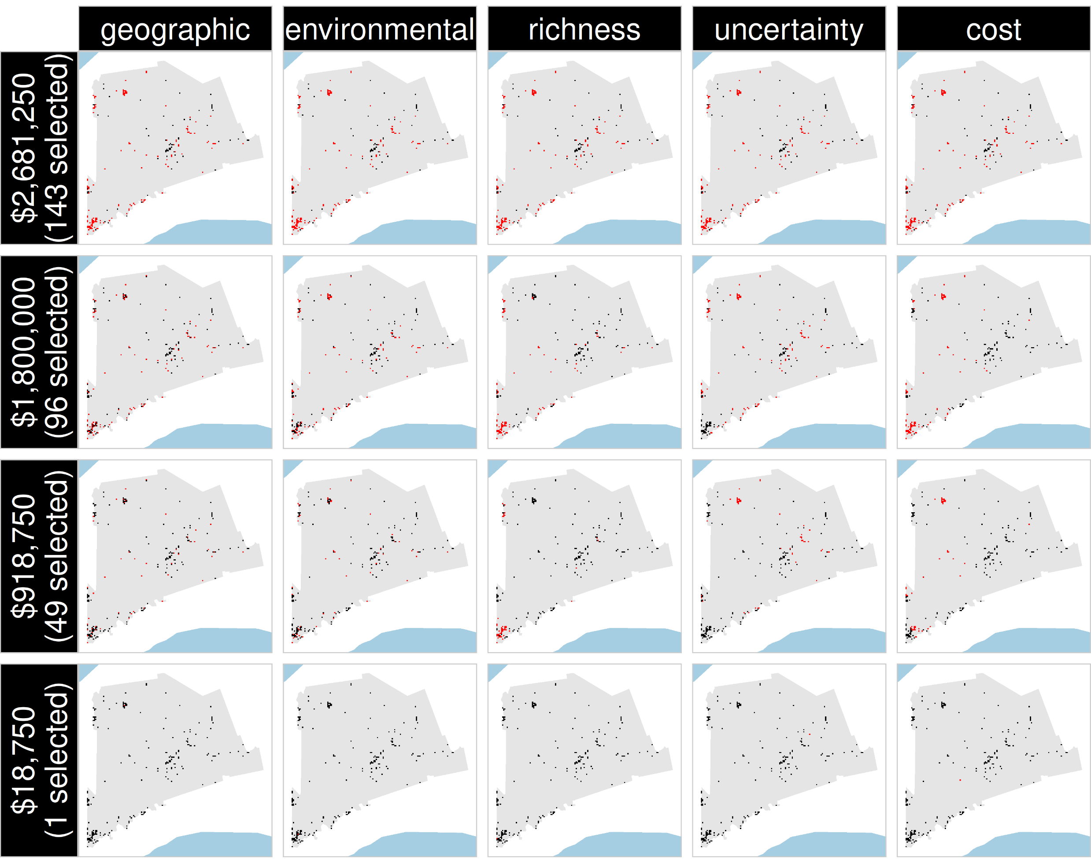
Selected
for survey
Number of places selected for surveys
(amount of funds allocated for collecting extra data)
NOT selected
for survey
Different approaches for designing survey schemes

Slide 30
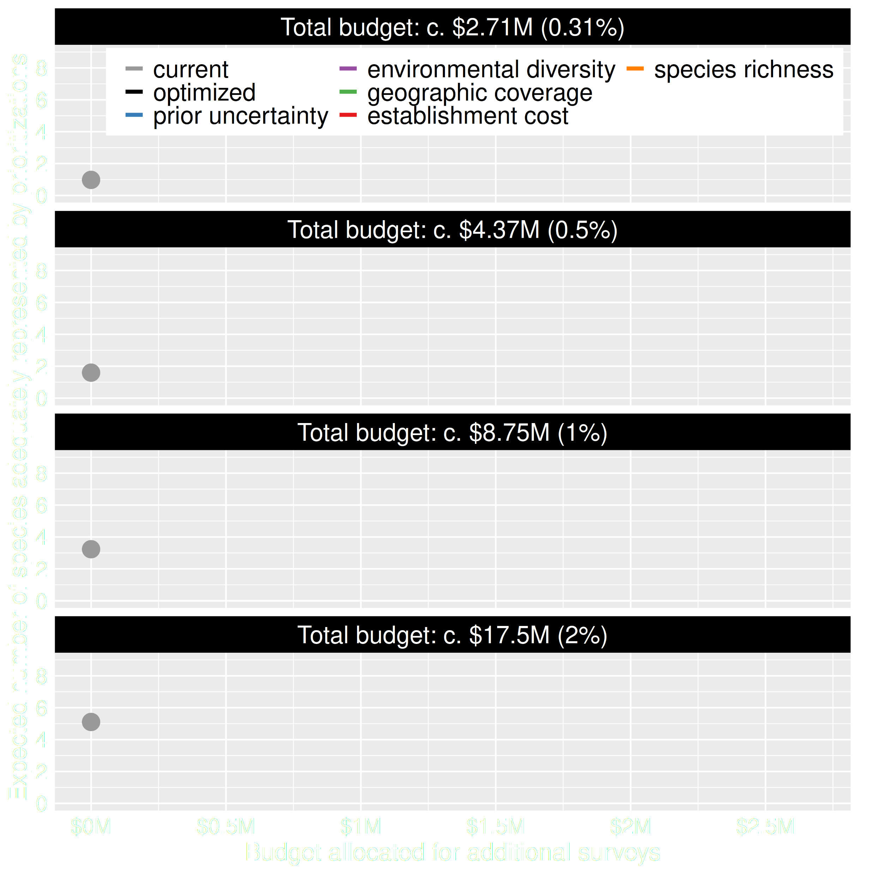
Value of information
Existing data leads to positive outcomes
More budget means better outcomes

Slide 31
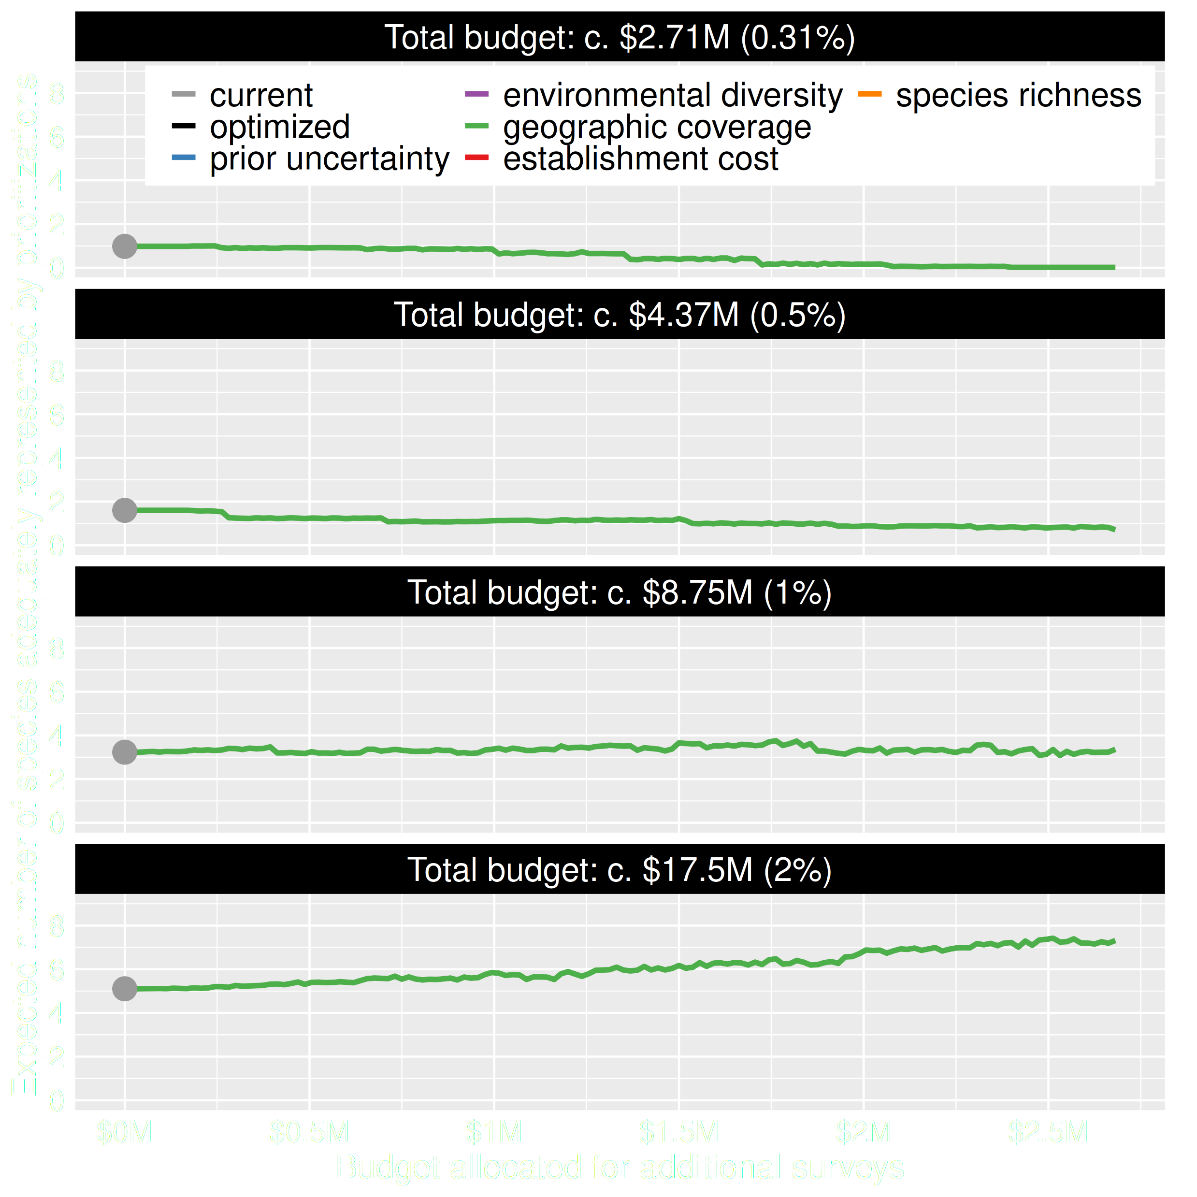
Value of information
Allocating funds for gathering more data can mean worse outcomes
Allocating funds for gathering more data can mean better outcomes too

Slide 32
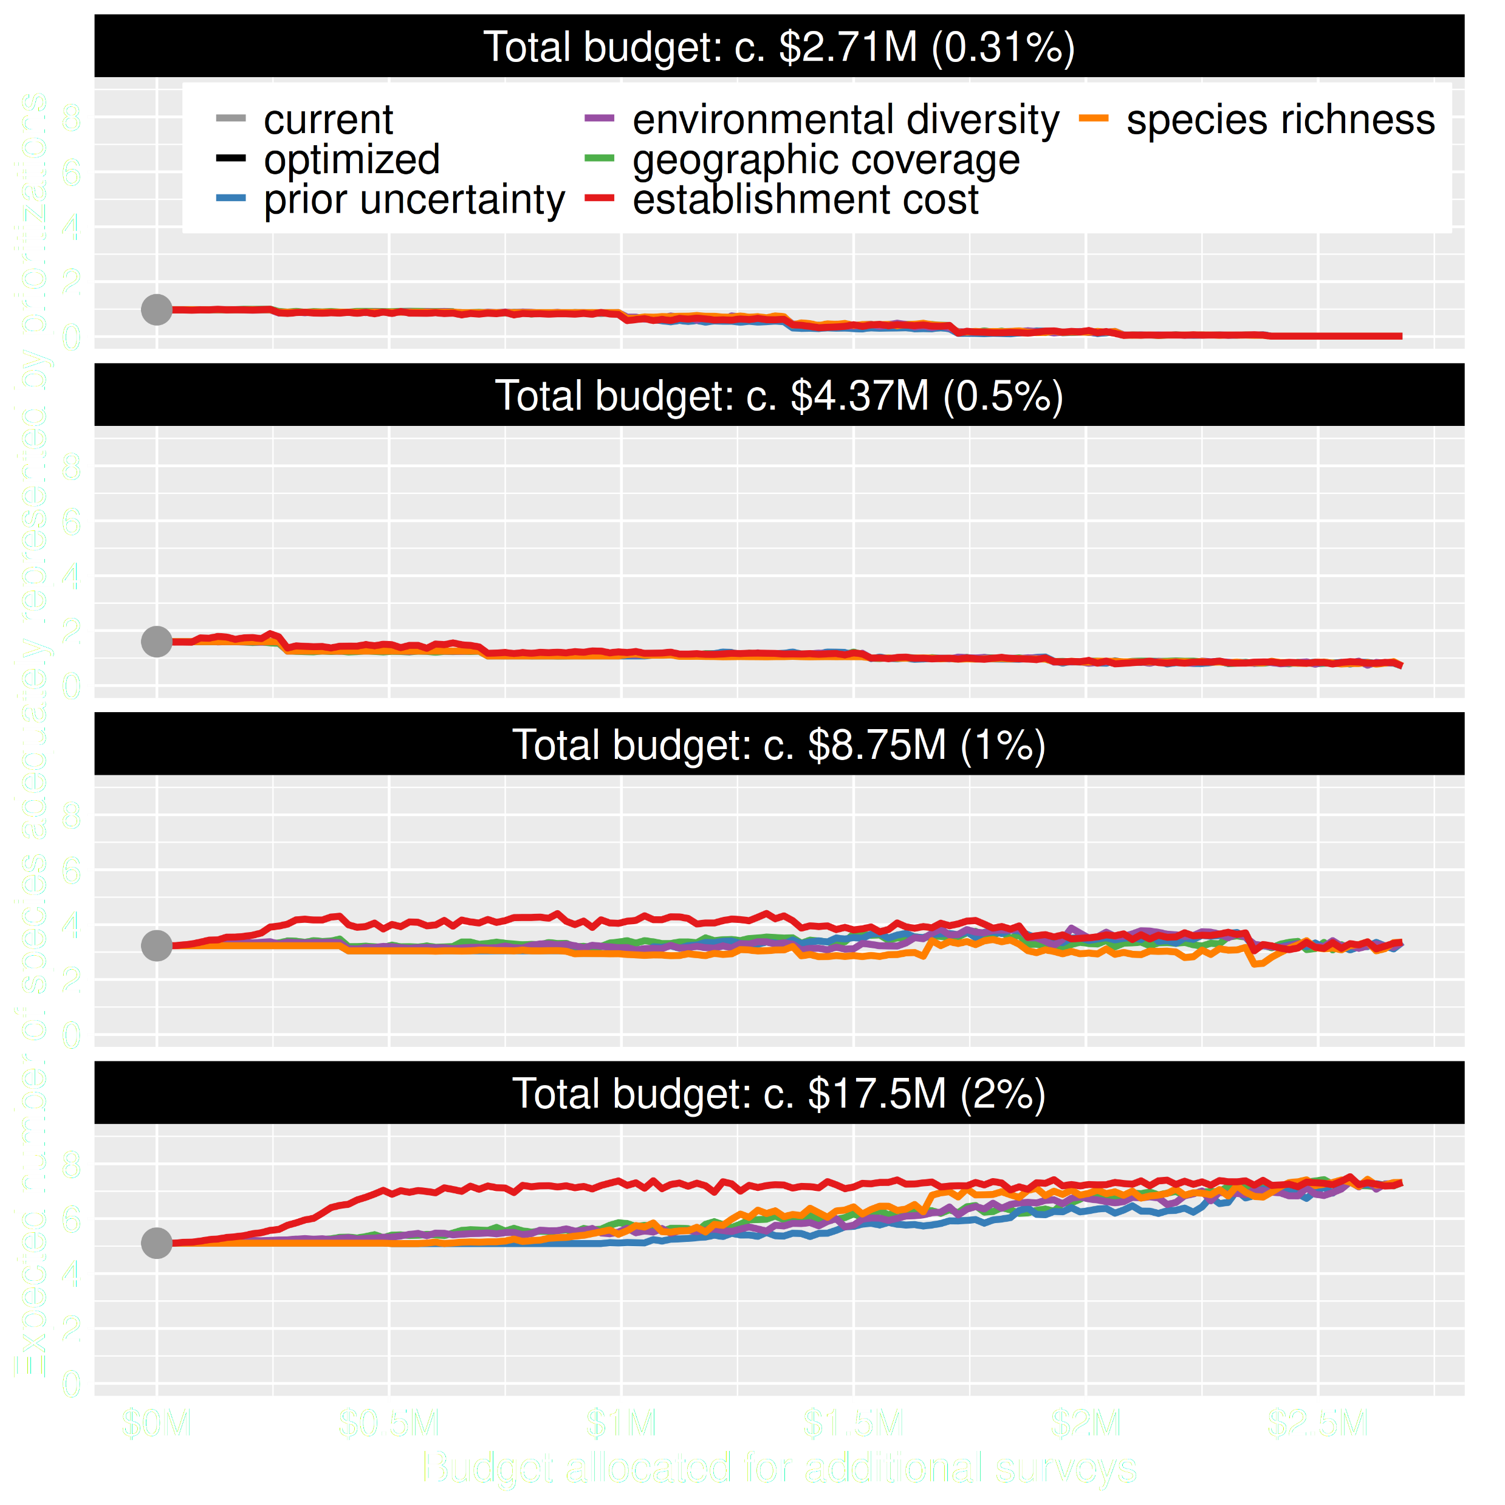
Value of information
Conventional approaches for gathering additional evidence have different performance
Performance of these approaches depends on available funds
All of them could lead to lead to worse outcomes

Slide 33
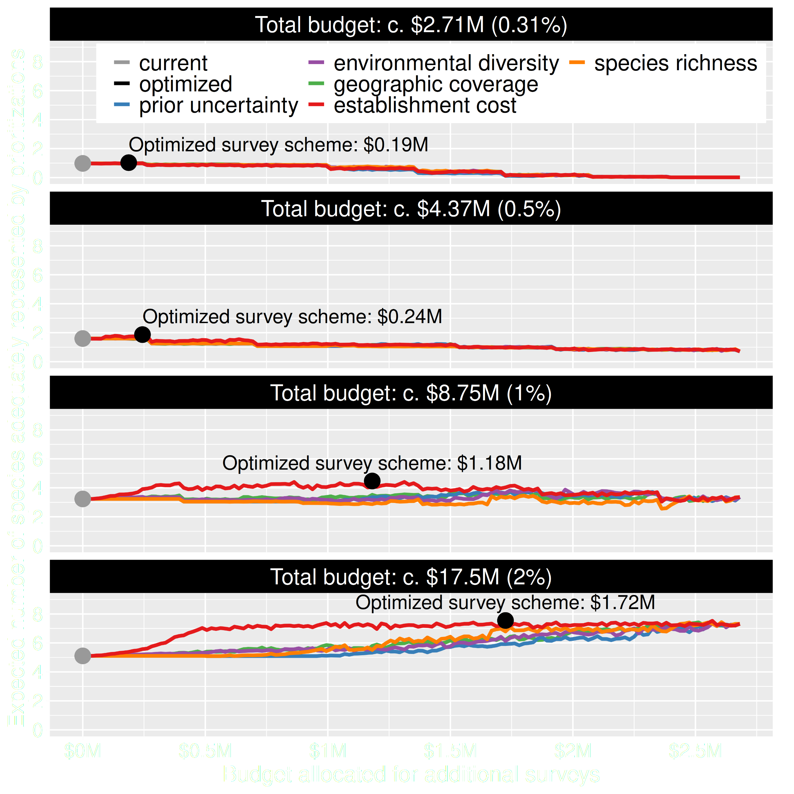
Value of information
Directly maximizing return on investment is best method for additional data
This considers objectives and constraints that underpin conservation plans and their success

Slide 34
How can we get a better conservation decision?
(1) Better algorithms
(2) Better data
(3) Better surrogates

Slide 35
Evolutionary processes
Species range
Population

Slide 36
Evolutionary processes
Species range
Population

Slide 37
Evolutionary processes
Species range
Population

Slide 38
Evolutionary processes
Species range
Population

Slide 39
Ecological surveys
Distribution maps
Priority areas
Biodiversity
2000
Future
Data
Information
Plan
Outcome
Better
understanding
of biodiversity
Better
plan
Better
outcome
Genetic samples
Objectives
Constraints
Notes:
39

Slide 40
Ecological surveys
Distribution maps
Priority areas
Biodiversity
2000
Future
Data
Information
Plan
Outcome
Good enough
understanding
of biodiversity
Better
plan
Better
outcome
Environment data
Hot
Objectives
Constraints
Cold
Notes:
40

Slide 41
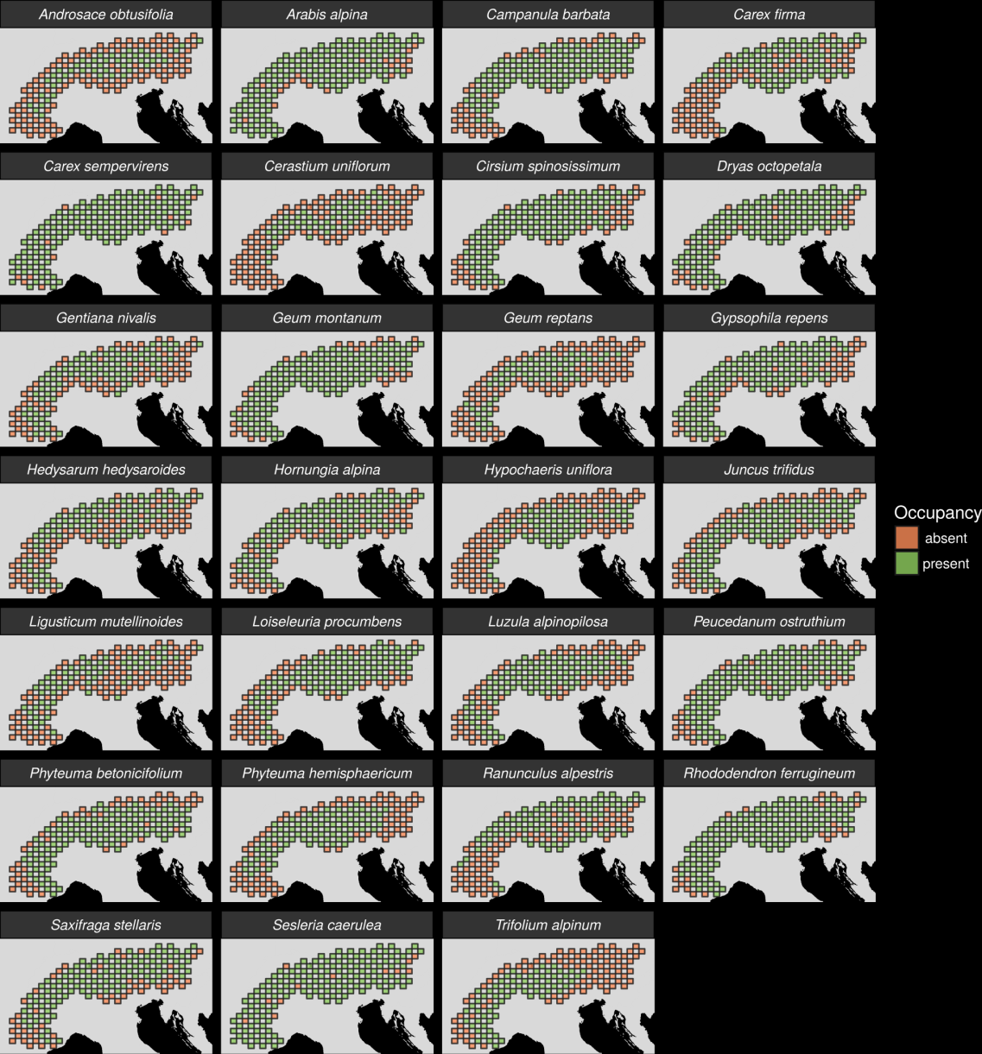
27 plant species
Different dispersal
Different life-histories
Different niches
AFLP markers
Hanson et al. 2017 PNAS

Slide 42
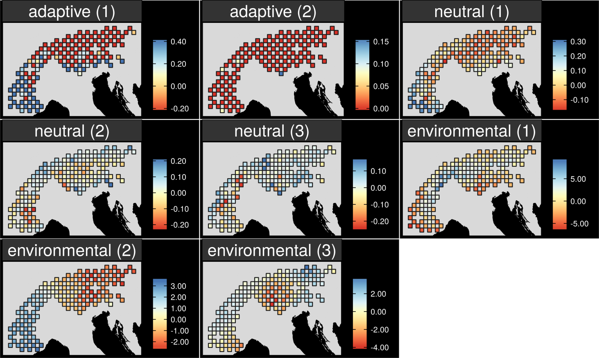
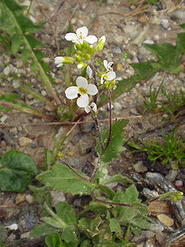
Map intra-specific variation
Arabis alpina
Hanson et al. 2017 PNAS
Notes:
42

Slide 43
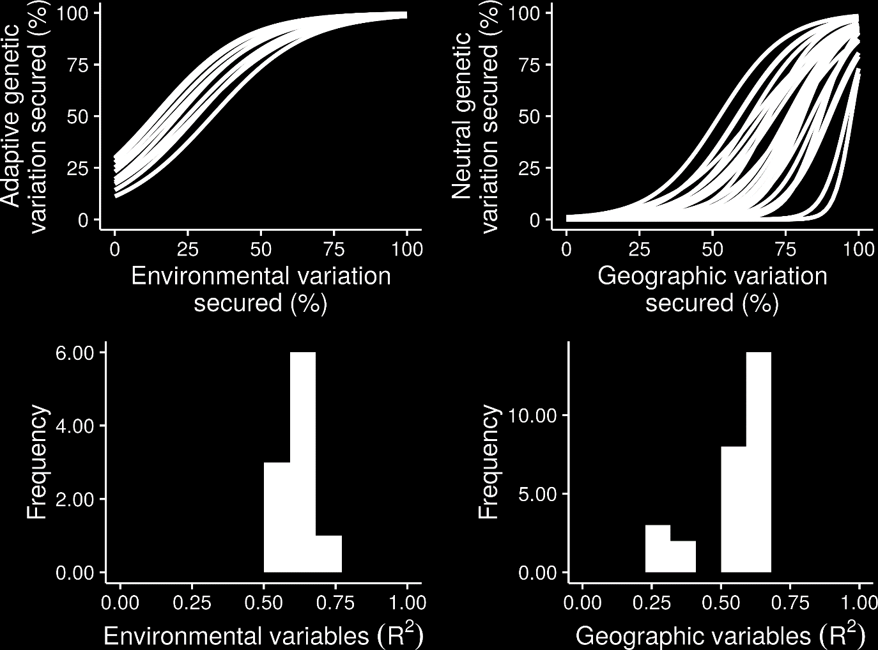
What is the relationship?
Hanson et al. 2017 PNAS

Slide 44
What is the relationship?
Hanson et al. 2017 PNAS

Slide 45
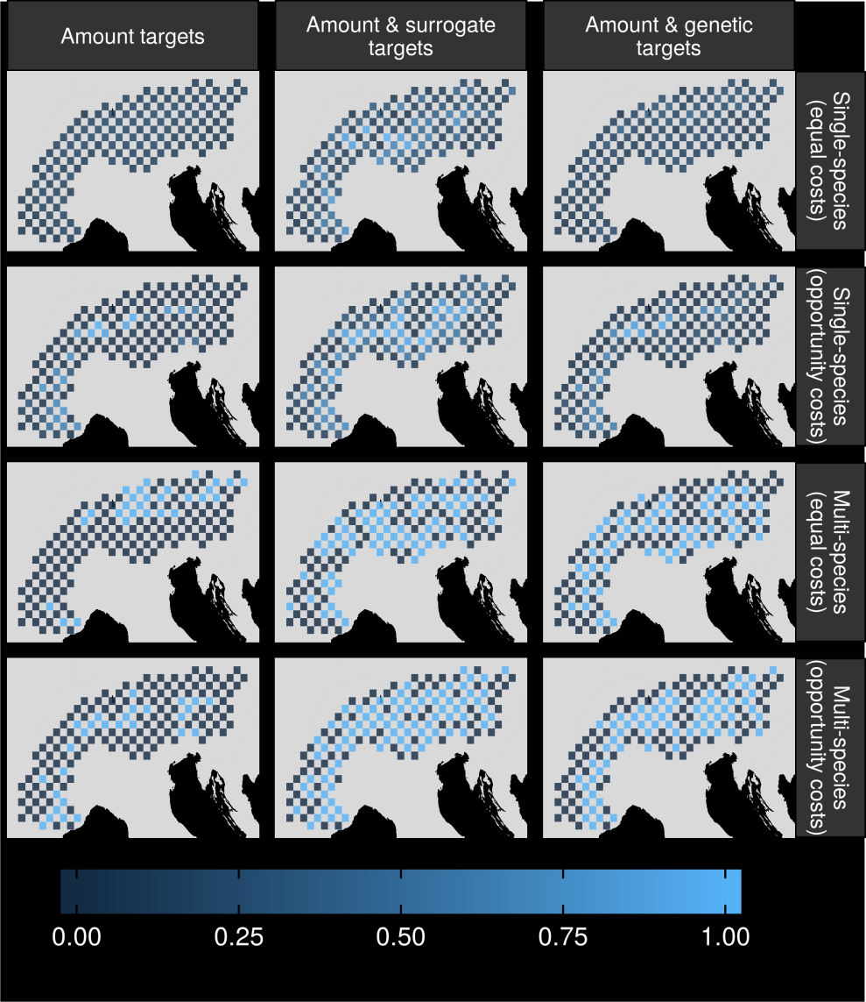
Can surrogates inform our decisions?
Hanson et al. 2017 PNAS

Slide 46
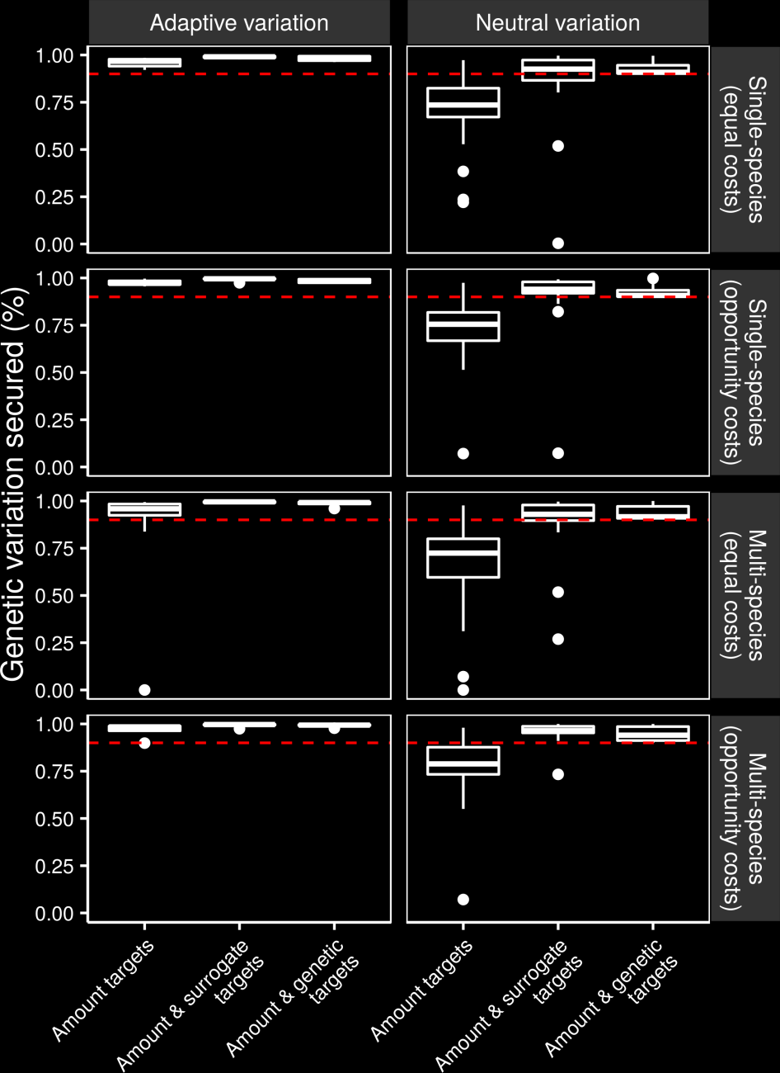
Can we make better decisions using surrogates?
Hanson et al. 2017 PNAS

Slide 47
Can we make better decisions using surrogates?
Hanson et al. 2017 PNAS

Slide 48
Global conservation of species niches
9,670 bird, 5,070 mammal, 5,197 amphibian species
5 × 5 km maps delineating suitable habitat
Split each species’ distribution into 10 “environmental” partitions
Habitat targets set following standard approaches
Hanson et al. 2020 Nature

Slide 49
Italian Agile Frog
Hanson et al. 2020 Nature

Slide 50
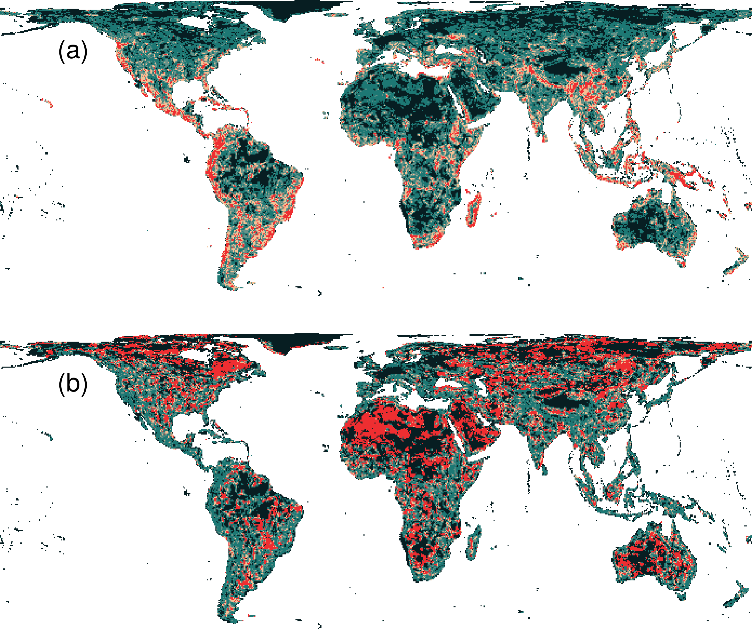
Prioritization for realized niches
35.9 % of the Earth’s land needed to complement existing protected areas
Biodiversity hotspots are critically important
Conservation efforts needed across the planet
Hanson et al. 2020 Nature

Slide 51
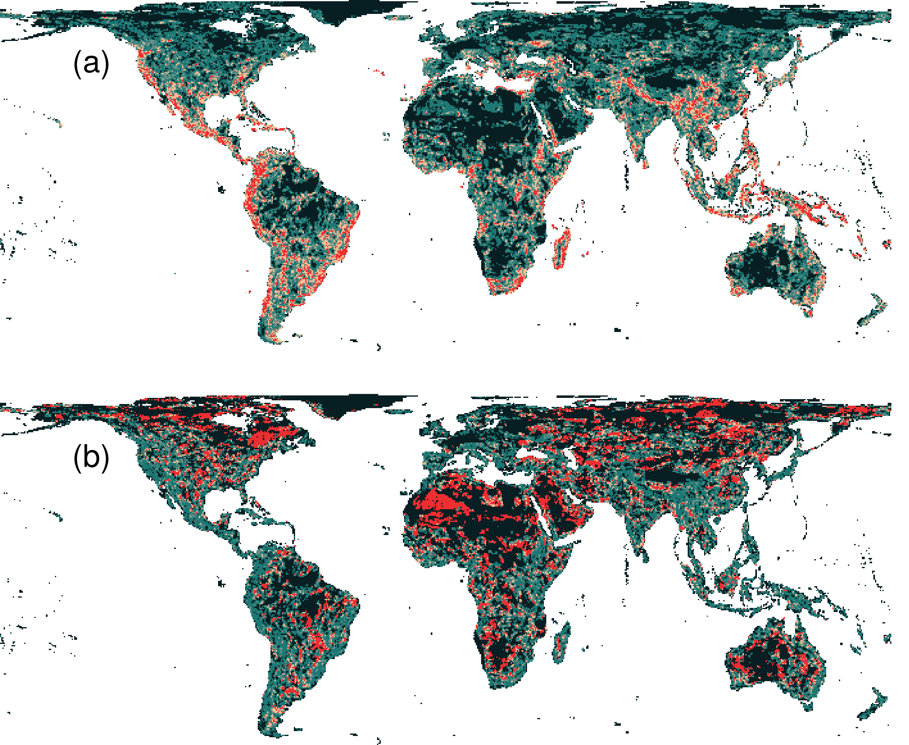
What if we ignore species’ niches?
Only 3.7% less of the Earth’s land than prioritization which considers niches
Fails to adequately represent 7,989 (40%) species
Hanson et al. 2020 Nature

Slide 52
Make better conservation decisions by using…
1. Better algorithms
2. Cost-effective data
3. Reliable surrogates

Slide 53




jeffrey.hanson@uqconnect.edu.au
github.com/jeffreyhanson
jeffrey-hanson.com

